Slide 1
ICS 143 - Principles of Operating Systems
Lectures 13-14 - Memory Management: Main Memory
Prof. Ardalan Amiri Sani
Prof. Nalini Venkatasubramanian
ardalan@uci.edu
nalini@ics.uci.edu

Slide 2
Outline
Background
Logical versus Physical Address Space
Swapping
Contiguous Allocation
Paging
Segmentation
Segmentation with Paging

Slide 3
Background
Program must be brought into memory and placed within a process for it to be executed.
Input Queue - collection of processes on the disk that are waiting to be brought into memory for execution.
User programs go through several steps before being executed.

Slide 4
Virtualizing Resources
Physical Reality: Processes/Threads share the same hardware
Need to multiplex CPU (CPU Scheduling)
Need to multiplex use of Memory (Today)
Why worry about memory multiplexing?
The complete working state of a process and/or kernel is defined by its data in memory (and registers)
Consequently, cannot just let different processes use the same memory
Probably don’t want different processes to even have access to each other’s memory (protection)

Slide 5
Important Aspects of Memory Multiplexing
Controlled overlap:
Processes should not collide in physical memory
Conversely, would like the ability to share memory when desired (for communication)
Protection:
Prevent access to private memory of other processes
Different pages of memory can be given special behavior (Read Only, Invisible to user programs, etc)
Kernel data protected from user programs
Translation:
Ability to translate accesses from one address space (virtual) to a different one (physical)
When translation exists, process uses virtual addresses, physical memory uses physical addresses

Slide 6
Names and Binding
Symbolic names → Logical names → Physical names
Symbolic Names: known in a context or path
file names, program names, printer/device names, user names
Logical Names: used to label a specific entity
inodes, job number, major/minor device numbers, process id (pid), uid, gid..
Physical Names: address of entity
inode address on disk or memory
entry point or variable address
PCB address

Slide 7
Binding of instructions and data to memory
Address binding of instructions and data to memory addresses can happen at three different stages.
Compile time:
If memory location is known a priori, absolute code can be generated; must recompile code if starting location changes.
Load time:
Must generate relocatable code if memory location is not known at compile time.
Execution time:
Binding delayed until runtime if the process can be moved during its execution from one memory segment to another. Need hardware support for address maps (e.g. base and limit registers).

Slide 8
Binding time tradeoffs
Early binding
compiler - produces efficient code
allows checking to be done early
allows estimates of running time and space
Delayed binding
Linker, loader
produces efficient code, allows separate compilation
portability and sharing of object code
Late binding
VM, dynamic linking/loading, overlaying, interpreting
code less efficient, checks done at runtime
flexible, allows dynamic reconfiguration

Slide 9
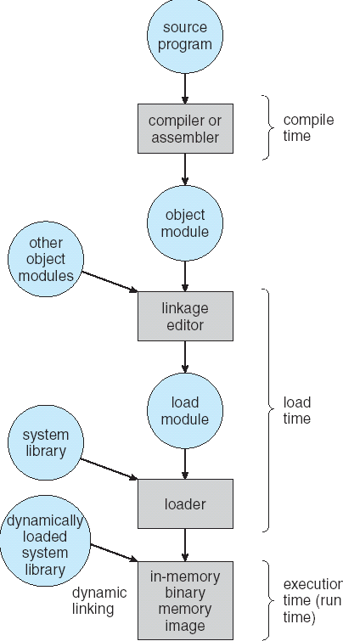
Multi-step Processing of a Program for Execution
Preparation of a program for execution involves components at:
Compile time (i.e., “gcc”)
Link/Load time (unix “ld” does link)
Execution time (e.g. dynamic libs)
Addresses can be bound to final values anywhere in this path
Depends on hardware support
Also depends on operating system
Dynamic Libraries
Linking postponed until execution
Small piece of code, stub, used to locate appropriate memory-resident library routine
Stub replaces itself with the address of the routine, and executes routine

Slide 10
Dynamic Loading
Routine is not loaded until it is called.
Better memory-space utilization; unused routine is never loaded.
Useful when large amounts of code are needed to handle infrequently occurring cases.
No special support from the operating system is required; implemented through program design.

Slide 11
Dynamic Linking
Linking postponed until execution time.
Small piece of code, stub, used to locate the appropriate memory-resident library routine.
Stub replaces itself with the address of the routine, and executes the routine.
Operating system needed to check if routine is in processes’ memory address.

Slide 12
Overlays
Keep in memory only those instructions and data that are needed at any given time.
Needed when process is larger than amount of memory allocated to it.
Implemented by user, no special support from operating system; programming design of overlay structure is complex.

Slide 13
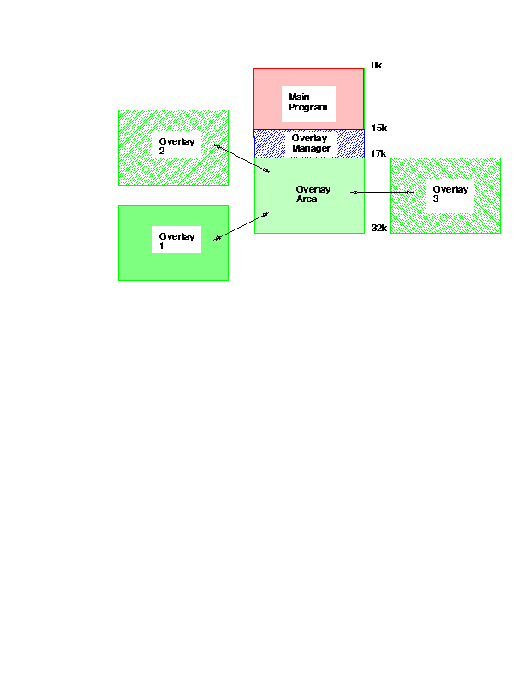
Overlaying

Slide 14
Logical vs. Physical Address Space
The concept of a logical address space that is bound to a separate physical address space is central to proper memory management.
Logical Address: or virtual address - generated by CPU
Physical Address: address seen by memory unit.
Logical and physical addresses are the same in compile time and load-time binding schemes
Logical and physical addresses differ in execution-time address-binding scheme.

Slide 15
Memory Management Unit (MMU)
Hardware device that maps virtual to physical address.
In MMU scheme, the value in the relocation register is added to every address generated by a user process at the time it is sent to memory.
The user program deals with logical addresses; it never sees the real physical address.

Slide 16
Swapping
A process can be swapped temporarily out of memory to a backing store and then brought back into memory for continued execution.
Backing Store - fast disk large enough to accommodate copies of all memory images for all users; must provide direct access to these memory images.
Roll out, roll in - swapping variant used for priority based scheduling algorithms; lower priority process is swapped out, so higher priority process can be loaded and executed.
Major part of swap time is transfer time; total transfer time is directly proportional to the amount of memory swapped.
Modified versions of swapping are found on many systems, i.e. UNIX and Microsoft Windows.

Slide 17
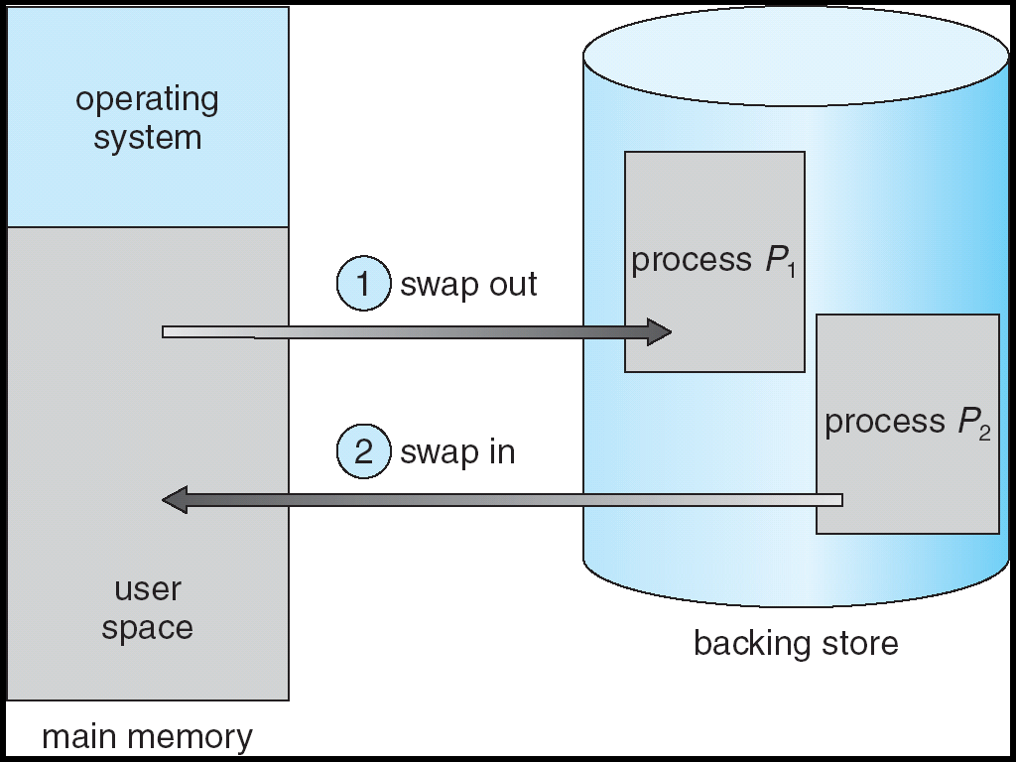
Schematic view of swapping

Slide 18
Contiguous Allocation
Main memory usually divides into two partitions
Resident Operating System, usually held in low memory with interrupt vector.
User processes then held in high memory.
Single partition allocation
Relocation register scheme used to protect user processes from each other, and from changing OS code and data.
Relocation register contains value of smallest physical address; limit register contains range of logical addresses - each logical address must be less than the limit register.

Slide 19
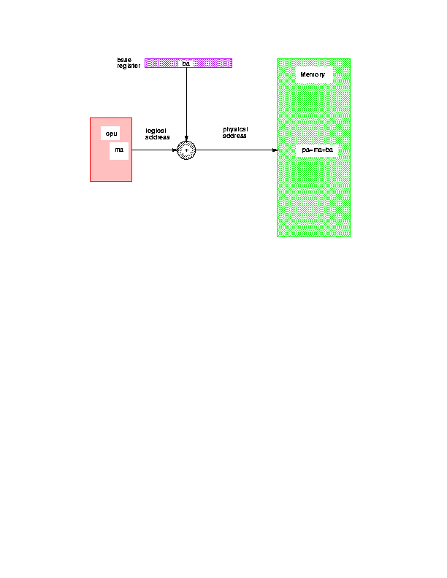
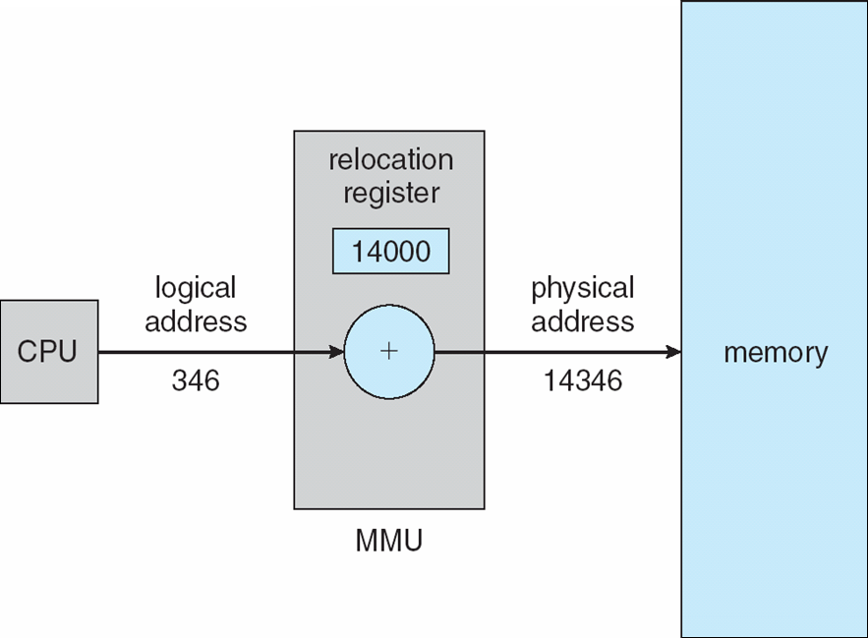
Relocation Register
Base register (ba)
Memory
CPU
Base register
Logical
address
(ma)
Physical
address
(pa)
pa = ba + ma

Slide 20
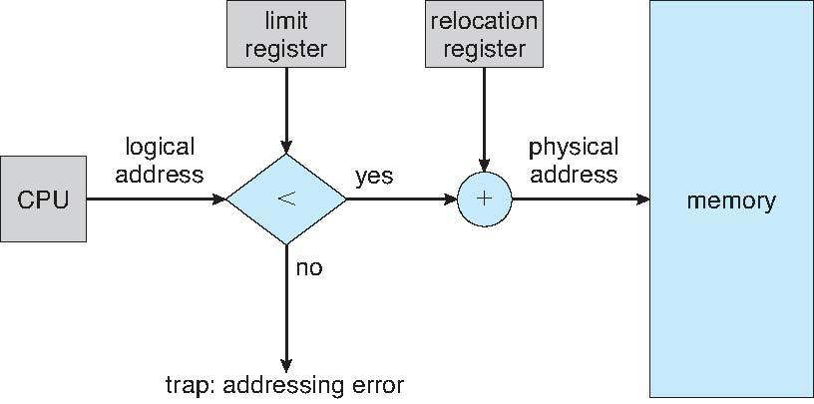
Relocation and Limit Registers

Slide 21
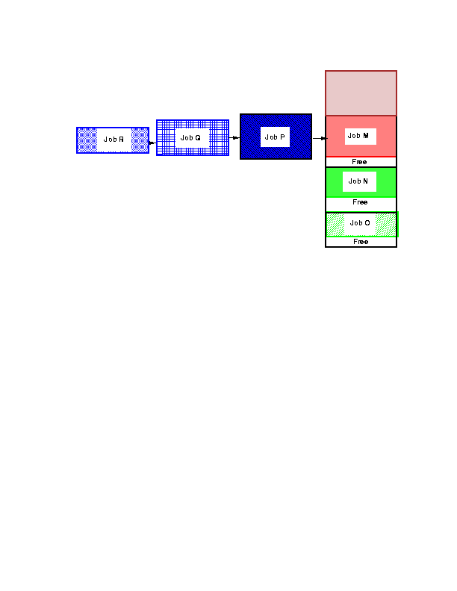
Fixed partitions

Slide 22
Contiguous Allocation (cont.)
Multiple partition Allocation
Hole - block of available memory; holes of various sizes are scattered throughout memory.
When a process arrives, it is allocated memory from a hole large enough to accommodate it.
Operating system maintains information about
allocated partitions
free partitions (hole)

Slide 23
Contiguous Allocation example
OS
OS
OS
OS
Process 5
Process 5
Process 5
Process 5
Process 9
Process 9
Process 8
Process 10
Process 2
Process 2
Process 2
Process 2

Slide 24
Dynamic Storage Allocation Problem
How to satisfy a request of size n from a list of free holes.
First-fit
allocate the first hole that is big enough
Best-fit
Allocate the smallest hole that is big enough; must search entire list, unless ordered by size. Produces the smallest leftover hole.
Worst-fit
Allocate the largest hole; must also search entire list. Produces the largest leftover hole.
First-fit and best-fit are better than worst-fit in terms of speed and storage utilization.

Slide 25
Fragmentation
External fragmentation
total memory space exists to satisfy a request, but it is not contiguous.
Internal fragmentation
allocated memory may be slightly larger than requested memory; this size difference is memory internal to a partition, but not being used.
Reduce external fragmentation by compaction
Shuffle memory contents to place all free memory together in one large block
Compaction is possible only if relocation is dynamic, and is done at execution time.
I/O problem - (1) latch job in memory while it is in I/O (2) Do I/O only into OS buffers.

Slide 26
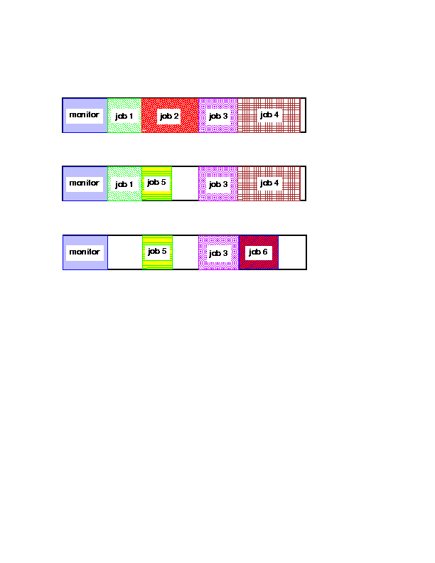
Fragmentation example

Slide 27
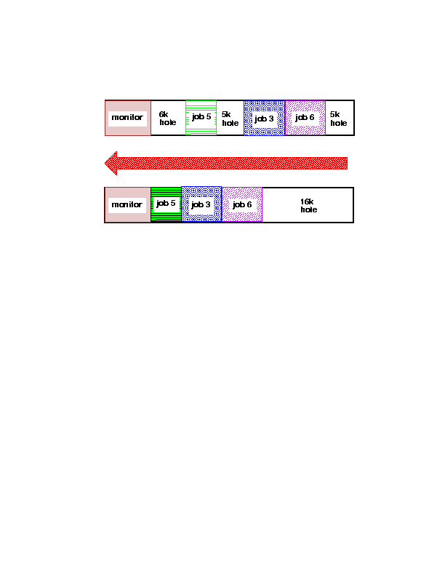
Compaction

Slide 28
Paging
Logical address space of a process can be non-contiguous;
process is allocated physical memory wherever the latter is available.
Divide physical memory into fixed size blocks called frames
size is power of 2, 512 bytes - 8K
Divide logical memory into same size blocks called pages.
Keep track of all free frames.
To run a program of size n pages, find n free frames and load program.
Set up a page table to translate logical to physical addresses.
Note:: Internal Fragmentation possible!!

Slide 29
Address Translation Scheme
Address generated by CPU is divided into:
Page number(p)
used as an index into page table which contains base address of each page in physical memory.
Page offset(d)
combined with base address to define the physical memory address that is sent to the memory unit.

Slide 30
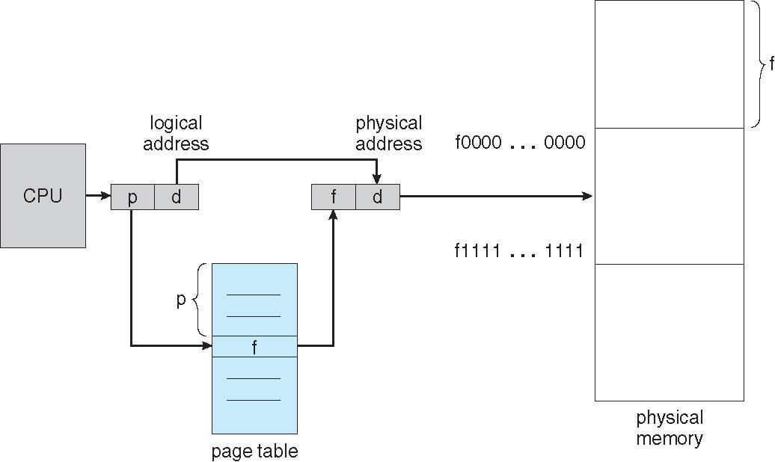
Address Translation Architecture
Physical
Memory
CPU
p
d
f
d
:
p
f
:

Slide 31
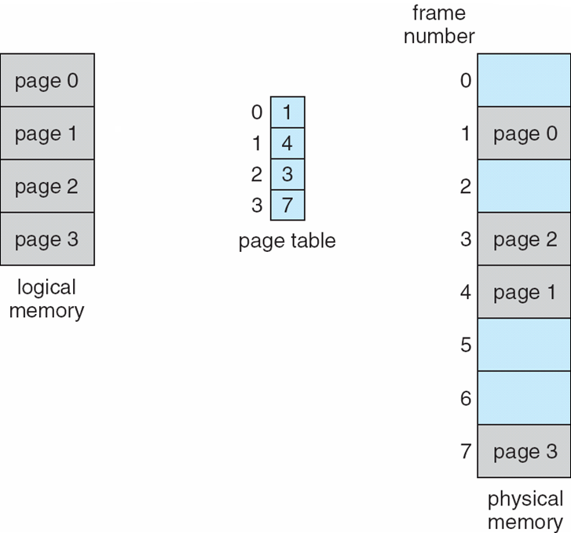
Example of Paging
Logical memory
Physical memory
Page 0
Page 0
Page 1
Page 2
Page 1
0
1
Page 2
1
3
Page 3
2
4
Page 3
3
7
:
:

Slide 32
Page Table Implementation
Page table is kept in main memory
Page-table base register (PTBR) points to the page table.
Page-table length register (PTLR) indicates the size of page table.
Every data/instruction access requires 2 memory accesses.
One for page table, one for data/instruction
Two-memory access problem solved by use of special fast-lookup hardware cache (i.e. cache page table in registers)
associative registers or translation look-aside buffers (TLBs)

Slide 33
Translation Lookaside Buffer (TLB) (aka Associative Registers)
Page #
Frame #
If A is in TLB, get frame #
Otherwise, need to go to page table for frame#
requires additional memory reference
Page Hit ratio - percentage of time page is found in TLB.
Address Translation
(A, A’)

Slide 34
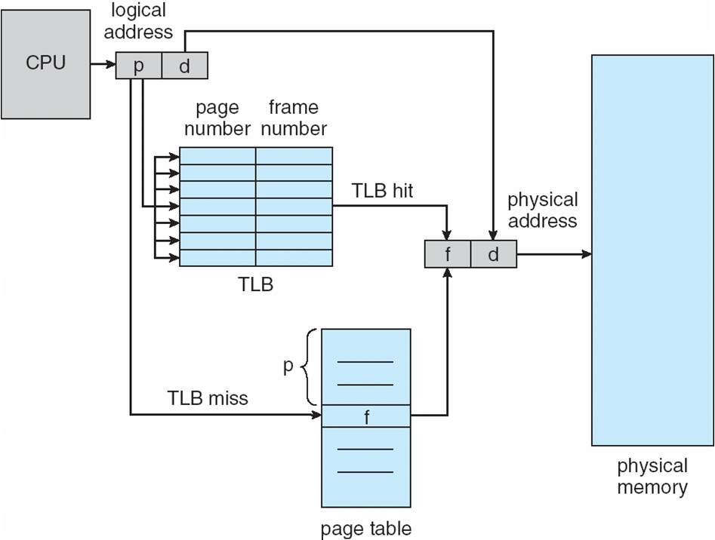
Paging hardware with TLB

Slide 35
Effective Access time
TLB lookup time = ε time unit
Assume Memory cycle time = 1 microsecond
Hit ratio = α
Effective access time (EAT)
EAT = (1+ ε) α + (2+ ε) (1-α)
EAT = 2+ ε - α

Slide 36
Memory Protection
Implemented by associating protection bits with each frame.
Valid/invalid bit attached to each entry in page table.
Valid: indicates that the associated page is in the process’ logical address space.
Invalid: indicates that the page is not in the process’ logical address space.

Slide 37
Two Level Page Table Scheme
Page of
page-tables
Physical memory
Outer-page table
1
:
:
500
100
:
:
:
708
:
929
:
:
900

Slide 38
Two Level Paging Example
A logical address (32bit machine, 4K page size) is divided into
a page number consisting of 20 bits, a page offset consisting of 12 bits
Since the page table is paged, the page number consists of
a 10-bit page number, a 10-bit page offset
Thus, a logical address is organized as (p1,p2,d) where
p1 is an index into the outer page table
p2 is the displacement within the page of the outer page table
Page number
Page offset
p1
p2
d

Slide 39
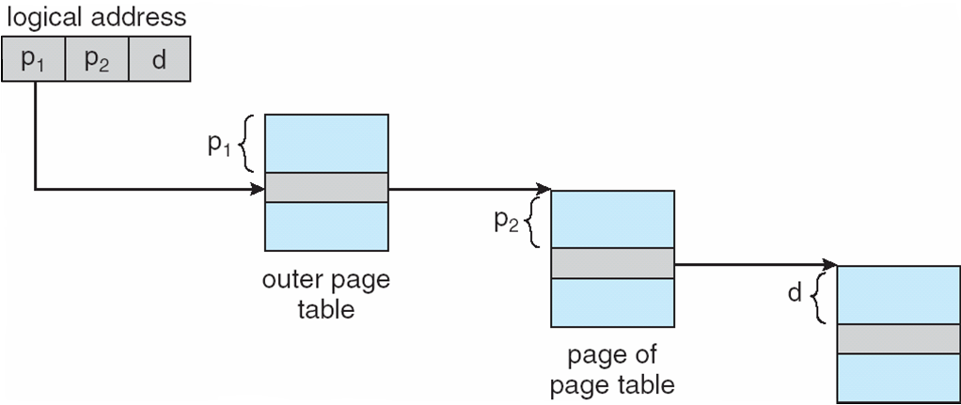
Two Level Paging Example

Slide 40
Multilevel paging
Each level is a separate table in memory
converting a logical address to a physical one may take 4 or more memory accesses.
Caching can help performance remain reasonable.
Assume cache hit rate is 98%, memory access time is quintupled (100 vs. 500 nanoseconds), cache lookup time is 20 nanoseconds
Effective Access time = 0.98 * 120 + .02 * 520 = 128 ns
This is only a 28% slowdown in memory access time...

Slide 41
Inverted Page Table
One entry for each real page of memory
Entry consists of virtual address of page in real memory with information about process that owns page.
Decreases memory needed to store page table
Increases time to search table when a page reference occurs
table sorted by physical address, lookup by virtual address
Use hash table to limit search to one (maybe few) page-table entries.

Slide 42
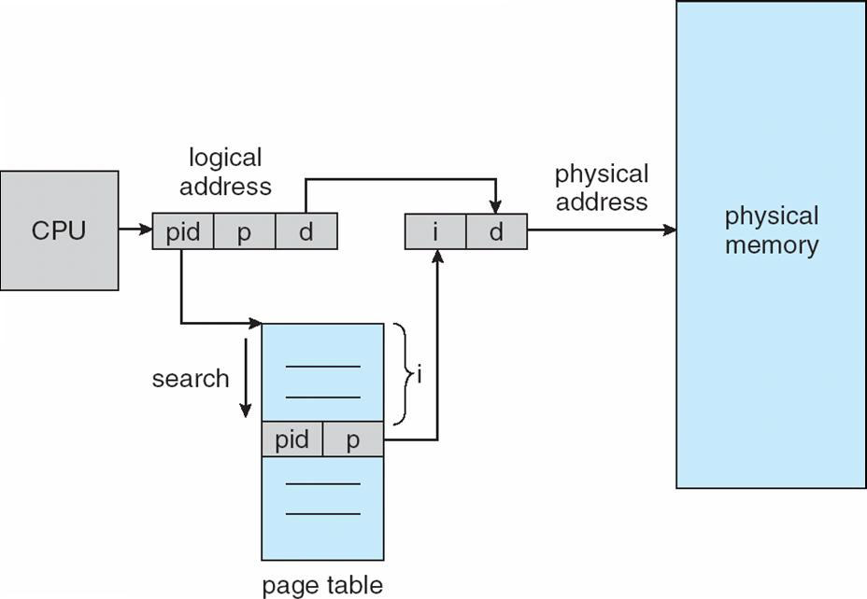
Inverted Page Table

Slide 43
Shared pages
Code and data can be shared among processes
Reentrant (non self-modifying) code can be shared.
Map them into pages with common page frame mappings
Single copy of read-only code - compilers, editors etc..
Shared code must appear in the same location in the logical address space of all processes
Private code and data
Each process keeps a separate copy of code and data
Pages for private code and data can appear anywhere in logical address space.

Slide 44
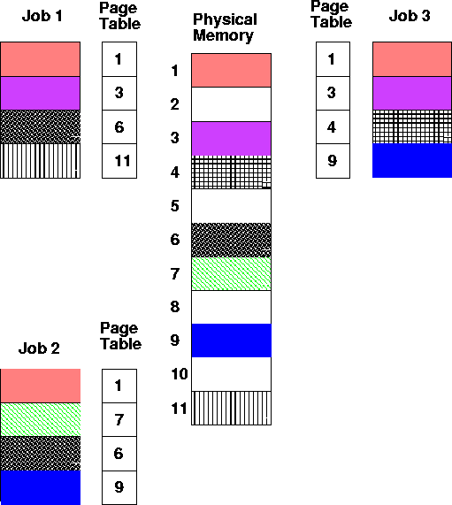
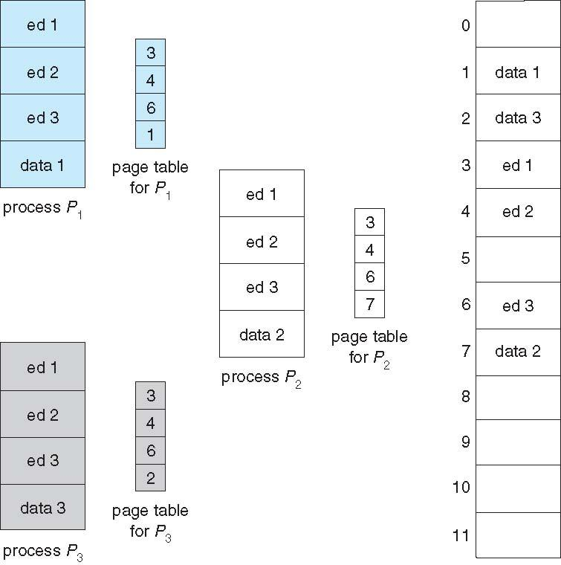
Shared Pages

Slide 45
Segmentation
Memory Management Scheme that supports user view of memory.
A program is a collection of segments.
A segment is a logical unit such as
main program, procedure, function
local variables, global variables,common block
stack, symbol table, arrays
Protect each entity independently
Allow each segment to grow independently
Share each segment independently

Slide 46
Logical view of segmentation
1
2
1
4
2
4
3
3
User Space
Physical Memory

Slide 47
Segmentation Architecture
Logical address consists of a two tuple
<segment-number, offset>
Segment Table
Maps two-dimensional user-defined addresses into one-dimensional physical addresses. Each table entry has
Base - contains the starting physical address where the segments reside in memory.
Limit - specifies the length of the segment.
Segment-table base register (STBR) points to the segment table’s location in memory.
Segment-table length register (STLR) indicates the number of segments used by a program; segment number is legal if s < STLR.

Slide 48
Segmentation Architecture (cont.)
Relocation is dynamic - by segment table
Sharing
Code sharing occurs at the segment level.
Shared segments must have same segment number.
Allocation - dynamic storage allocation problem
use best fit/first fit, may cause external fragmentation.
Protection
protection bits associated with segments
read/write/execute privileges
array in a separate segment - hardware can check for illegal array indexes.

Slide 49
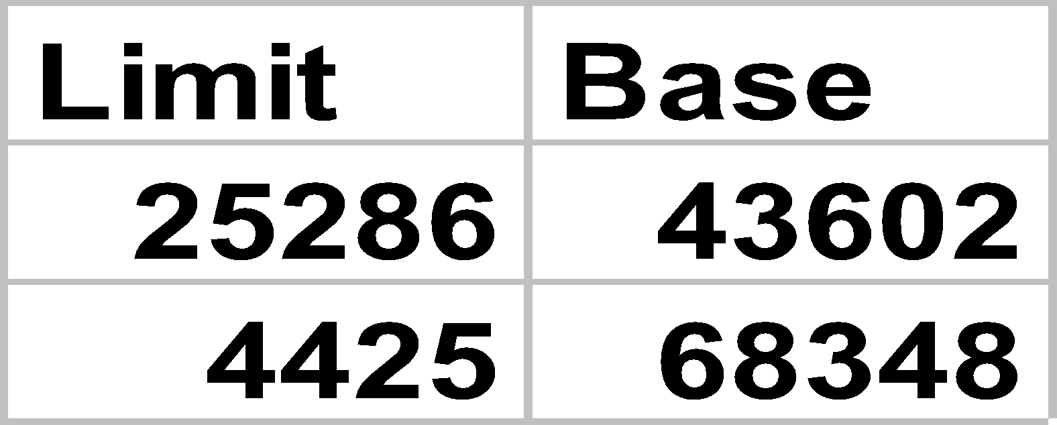
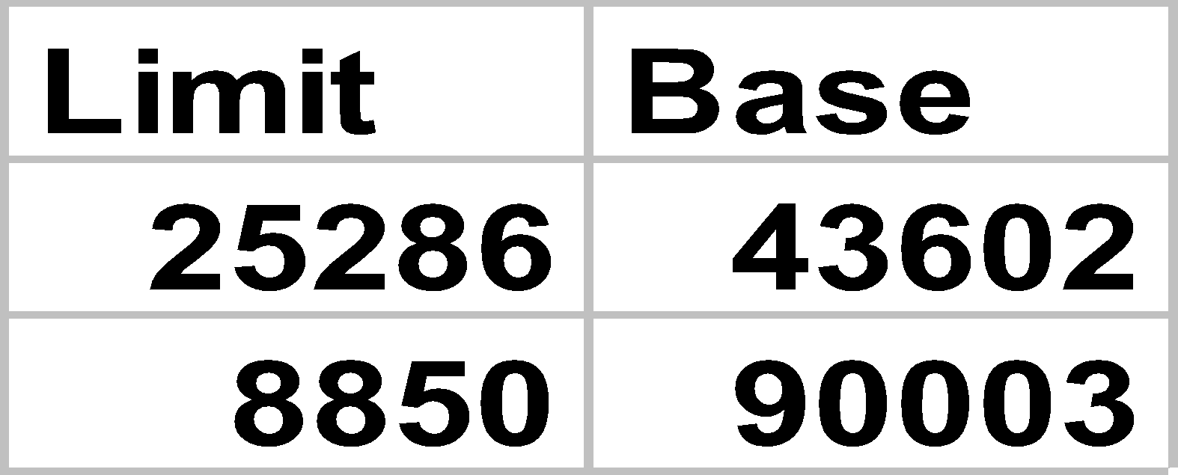
Shared segments
editor
0
segment 0
1
43062
data 1
Segment Table
process P1
editor
68348
data 1
data 1
segment 1
72773
Logical Memory
process P1
editor
90003
data 2
0
data 2
segment 0
1
98553
Segment Table
process P2
Logical Memory
process P2
segment 1

Slide 50
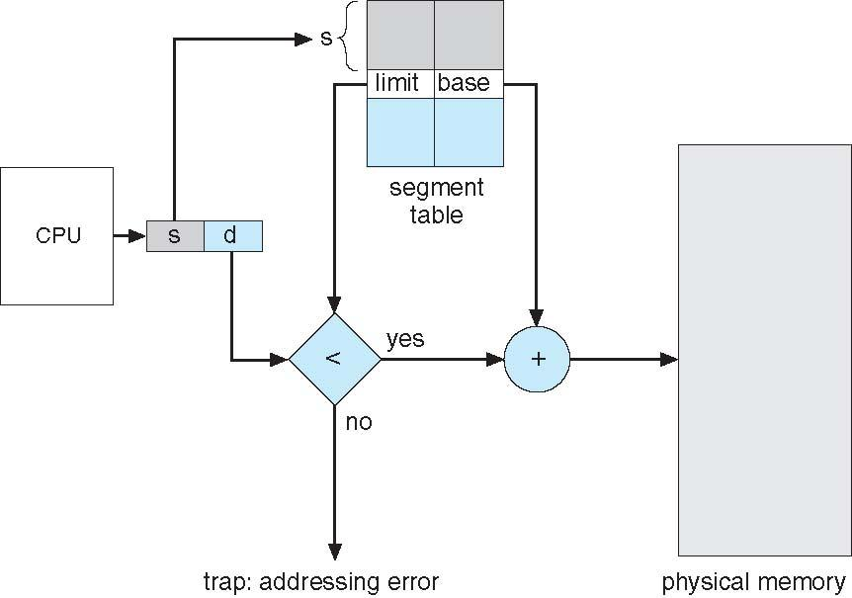
Segmentation hardware

Slide 51
Segmented Paged Memory
Segment-table entry contains not the base address of the segment, but the base address of a page table for this segment.
Overcomes external fragmentation problem of segmented memory.
Paging also makes allocation simpler; time to search for a suitable segment (using best-fit etc.) reduced.
Introduces some internal fragmentation and table space overhead.
Multics - single level page table
IBM OS/2 - OS on top of Intel 386
uses a two level paging scheme

Slide 52
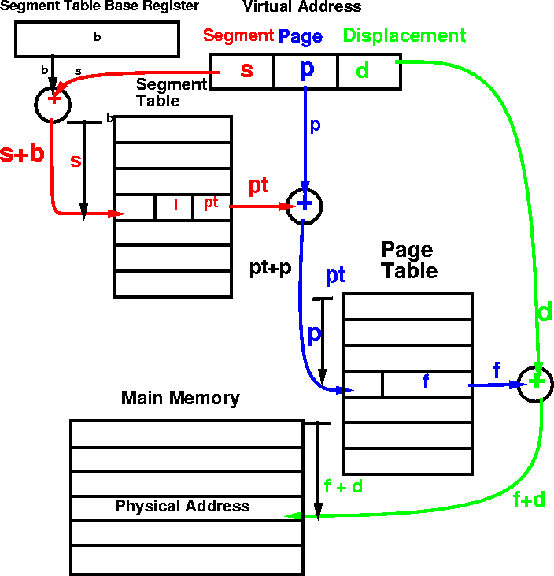
MULTICS address translation scheme
52

